Slide 1
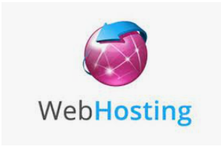
Install a web server and publish a website on Intranet

Slide 2
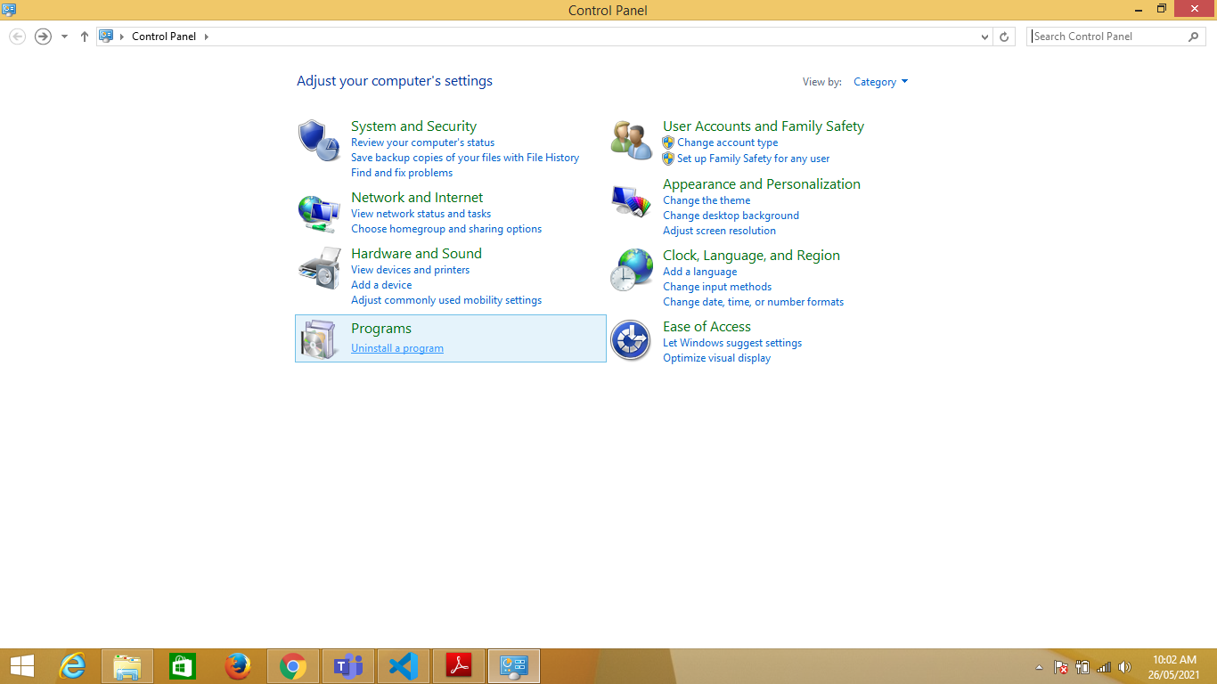
1. Go to control Panel and choose Programs option

Slide 3
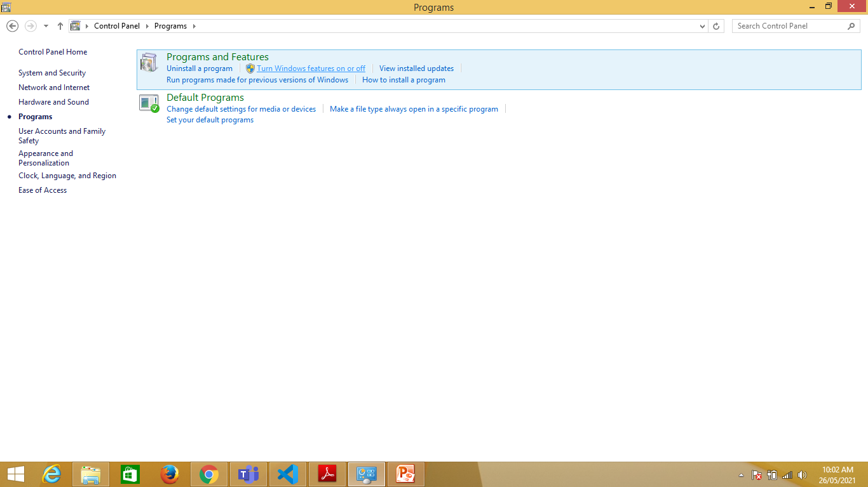
2.From Program and Features menu select “Turn Windows features on or off”

Slide 4
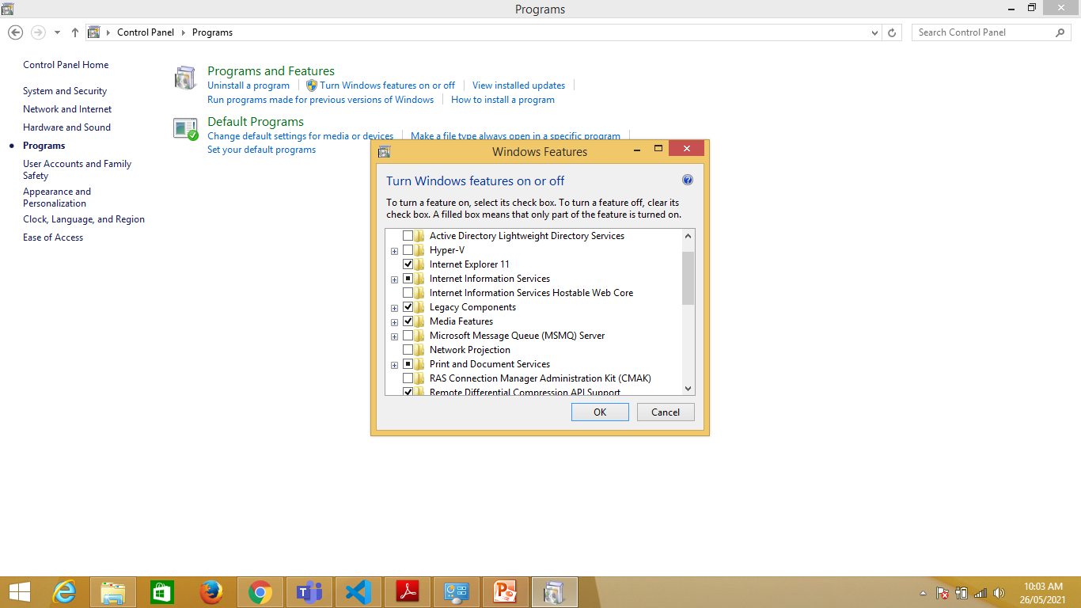
3.Select Internet Information Services and click OK

Slide 5
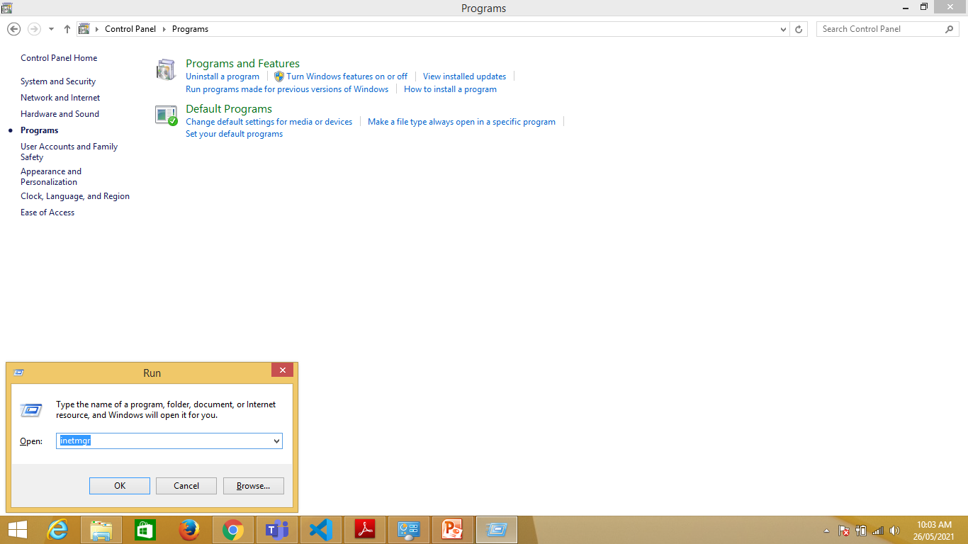
4.Press Window key and R key simultaneously and type “inetmgr” command to open Internet Information services manager”

Slide 6
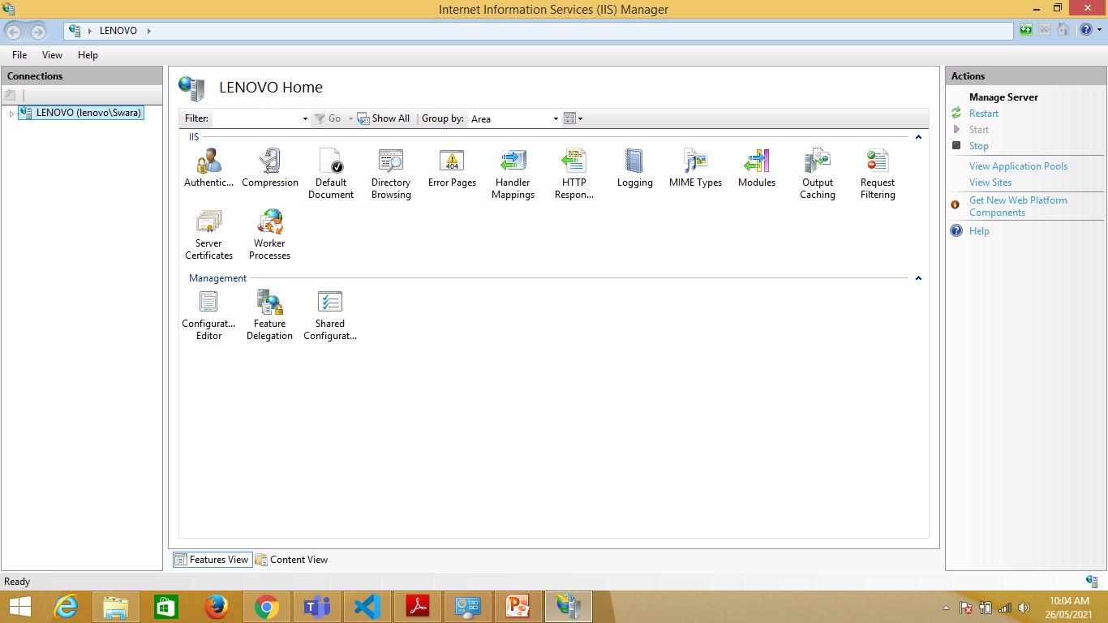

Slide 7
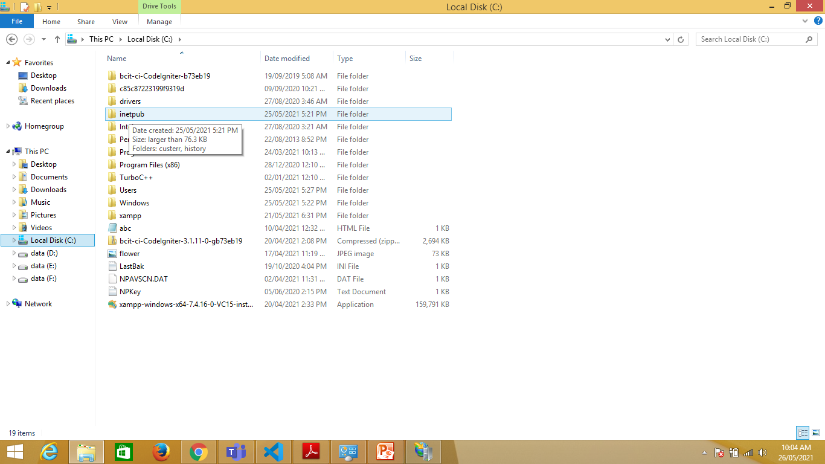
5.Go to C Drive and go to folder C:\inetpub\wwwroot folder and copy your website files in new folder

Slide 8
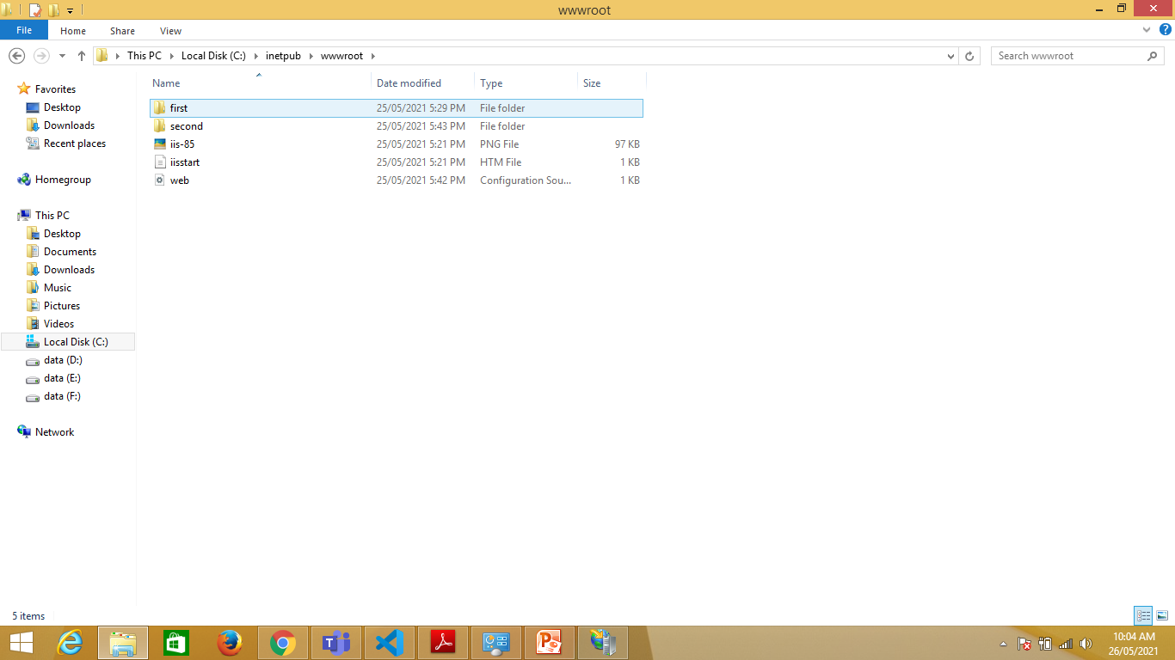

Slide 9
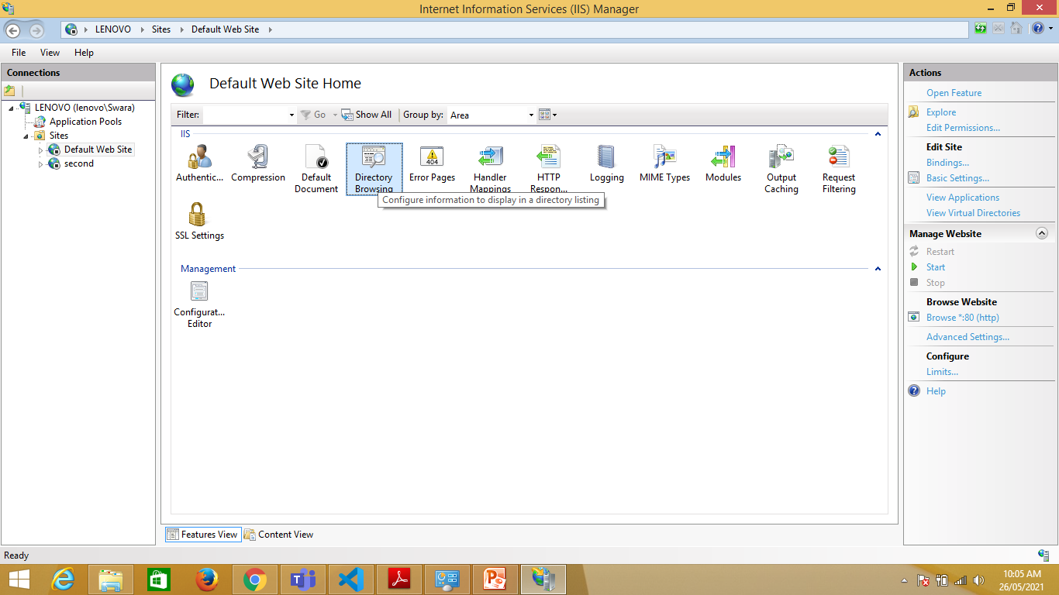
6.Choose Directory Browsing Option from IIS manager

Slide 10
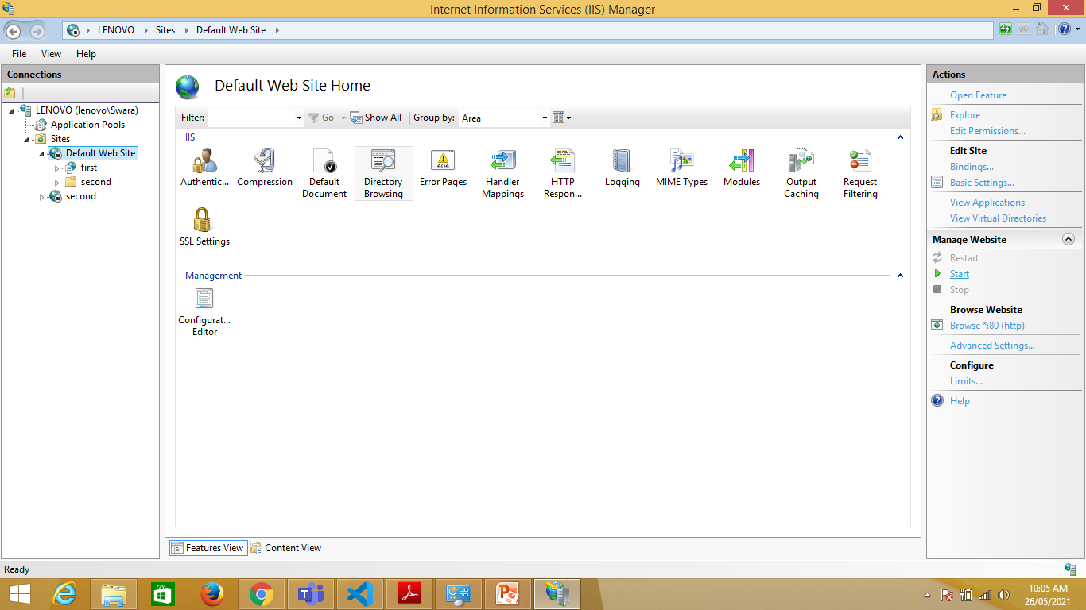
7.In right side go to actions and select Enable link. Also click on start link

Slide 11
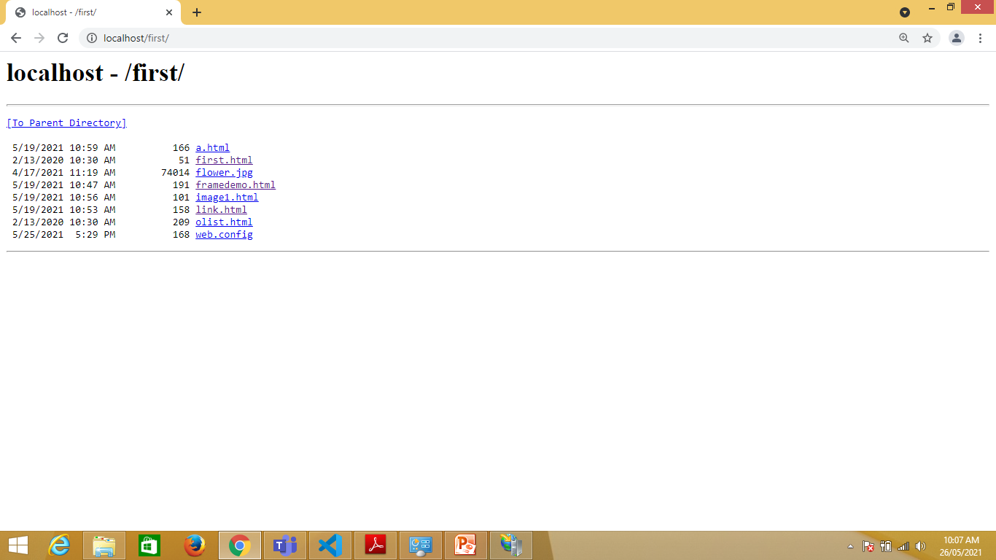
8.To verify go to browser and type localhost/folder name/ and press enter.
Eg.localhost/first/

